Slide 1
Hack the Future:
A Gen AI Sprint Powered by Data

Slide 2

Guidelines
The template should consist of the following and it is mandated to be used by your team for submitting your innovative ideas/solutions. Follow file naming format: Team name_Idea Name.pptx

Slide 3






Hack the Future: A Gen AI Sprint Powered by Data
Data and AI Week
Team details
TEAM NAME: Zeal Gen AI
Meeturi Ajay Kumar (Team Leader)
Aitha Riyesh
Photo

Slide 4
Entry Submission Summary
Idea Title (Provide a concise and impactful title for your idea.) | TalentSync AI - Intelligent Multi-Agent System for Automated Job-CV Screening
Team Name | Zeal Gen AI
Problem Statement | Problem Statement 5: Enhancing Job Screening with AI and Data Intelligence The recruitment process often involves manually reviewing numerous job descriptions (JDs) and CVs, which can be time-consuming and prone to human error. The goal of this hackathon is to develop a multi-agentic AI system that can automatically read and summarize job descriptions (JDs), match candidate qualifications with the JD, shortlist candidates, and send interview requests based on the match
Proposed Solution | LangChain-powered pipeline with four agents: JD summarizer, CV processor, eligibility evaluator, and email notifier JD Agent distills job descriptions into concise responsibilities and qualifications CV Agent chunks resumes, generates embeddings with HuggingFace MiniLM, and stores them in FAISS for fast retrieval Eligibility Agent uses a Groq LLM to decide suitability and the Email Agent automates personalized notifications.

Slide 5
Problem statement you are trying to address
Problem Statement 5: Enhancing Job Screening with AI and Data Intelligence
Challenge Overview:
The recruitment process often involves manually reviewing numerous job descriptions (JDs) and CVs, which can be time-consuming and prone to human error. The goal of this hackathon is to develop a multi-agentic AI system that can automatically read and summarize job descriptions (JDs), match candidate qualifications with the JD, shortlist candidates, and send interview requests based on the match
Current Process:
Job Description Summarizer: Reads and summarizes key elements from the JD, including required skills, experience, qualifications, and job responsibilities.
Recruiting agent: Extracts key data from CVs, such as education, work experience, skills, certifications, and other relevant information. Compares the extracted data from the CV to the summarized JD and calculates a match score based on the relevance of the candidate's qualifications, experience, and skills.
Shortlisting Candidates: Based on the match score, candidates who meet or exceed a defined threshold (e.g., 80% match) are shortlisted for interviews.
Interview Scheduler: Sends personalized interview requests to shortlisted candidates, including potential dates, times, and interview format written in email.

Slide 6
Proposed Solution Overview
Seamless Data Ingestion & Validation Users upload or enter job descriptions and CVs using the sidebar, where inputs are automatically checked for format and stored in versioned CSV/PDF repositories.
Intelligent Job Description Summarization A LangChain LLM chain ingests each JD and instantly distills it into a concise list of core responsibilities and must‑have qualifications, eliminating manual review.
Robust Resume Chunking & Semantic Embedding CVs are split into 500‑token segments, embedded using HuggingFace’s MiniLM model, and indexed in FAISS—enabling lightning‑fast, context‑aware similarity searches.
Insightful Eligibility Evaluation A Groq‑powered LLM agent compares JD summaries against CV embeddings to deliver a definitive “Suitable” or “Not Suitable” verdict, complete with transparent, criteria‑based reasoning.
Automated Communication & Modular UI Personalized selection or rejection emails are dispatched via SMTP, and the entire pipeline is orchestrated through an intuitive web interface—offering real‑time feedback, scalability, and plug‑and‑play extensibility.

Slide 7
Technologies Used
Language & Core Libraries: Python3.13.2, os, json, re, base64
Back‑End & Orchestration: Python 3.x, Flask, LangChain (Agents, LLMChain, PromptTemplate, Tool API)
Front‑End: Flask templates (HTML, JavaScript), Tailwind CSS, Flowbite
Large Language Model: Groq ChatGroq (mistral‑saba‑24b)
Embeddings & Vector Store: HuggingFaceEmbeddings (MiniLM‑L6‑v2) + FAISS
Document Processing: PyPDFLoader for PDF ingestion, RecursiveCharacterTextSplitter for chunking
Data Handling & Storage: Pandas for CSV read/write
Environment Management: python‑dotenv for secure API keys
Email Automation: smtplib & email.mime for SMTP‑based notifications

Slide 8
Agents' interaction design
Result Displayed on Website (UI)
with live feedback & reasoning
User Uploads JD & CV via Flask UI
JD AGENT
Summarizes job description into key roles & must-haves
EMAIL AGENT
Sends selection/rejection mail based on result
CV AGENT
Extracts text chunks from CV and embeds them
EVALUATION AGENT
Outputs: "Suitable" / "Not Suitable" with reasoning
VECTOR EMBEDDING + FAISS INDEXING

Slide 9
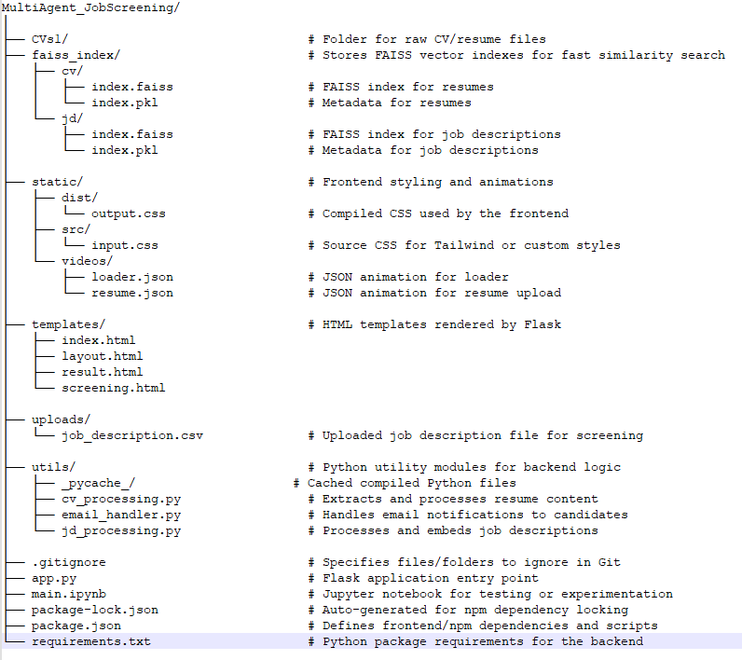
Code structure

Slide 10
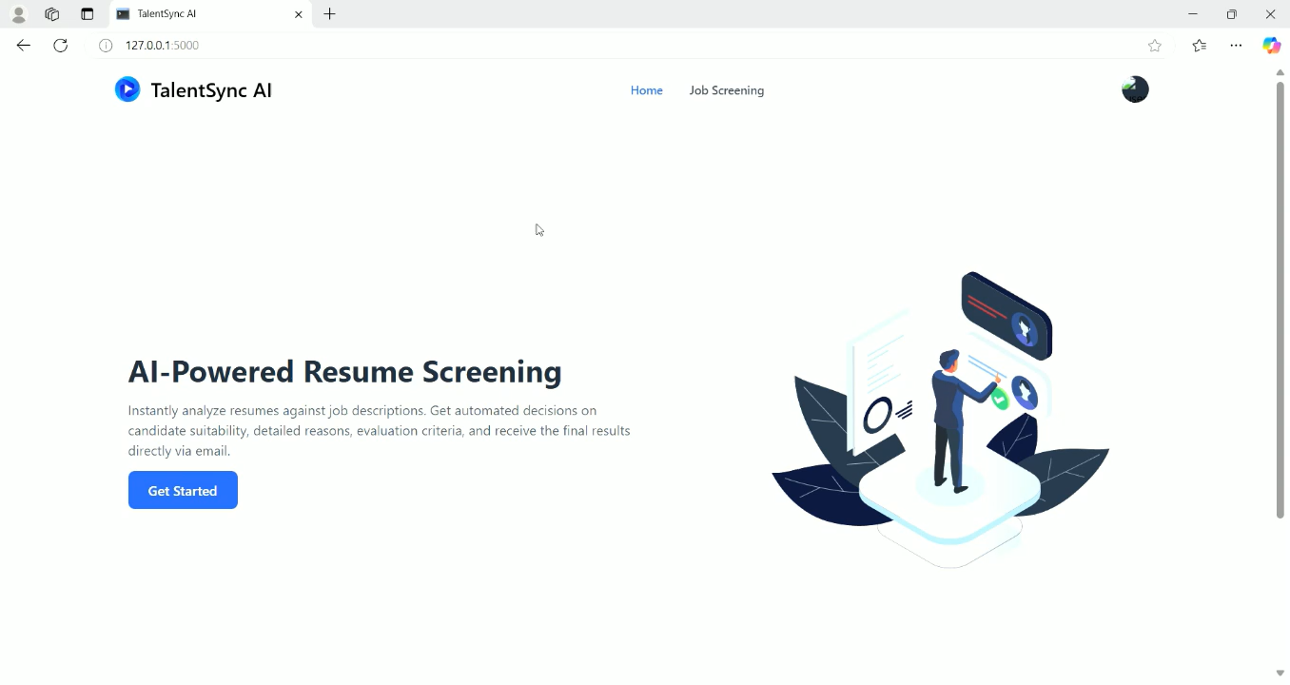
Demo video

Slide 11
Conclusion
Our AI-powered multi-agent solution revolutionizes the job screening process by automating resume evaluation against job descriptions with unmatched speed and accuracy. Leveraging LangChain for orchestration and Groq LLMs for intelligent reasoning, it eliminates manual shortlisting, reducing HR effort drastically.
The modular design—spanning parsing, eligibility checks, evaluation, and personalized email handling—ensures scalability, maintainability, and real-world applicability. With real-time responses, transparent reasoning, and seamless UI via Flask + Tailwind CSS, the system addresses the core problem: fast, fair, and efficient candidate screening.

Slide 12
References/Other details
LangChain Framework – Used for orchestrating the modular agent flow 🔗 https://www.langchain.com
HuggingFace Transformers – For MiniLM embedding of textual data 🔗 https://huggingface.co
FAISS (Facebook AI Similarity Search) – Enables fast and efficient vector indexing
🔗 https://github.com/facebookresearch/faiss
Groq LLM API – Powers low-latency, real-time eligibility decisioning 🔗 https://groq.com
SMTP Integration – Automated email delivery for results (using smtplib)

Slide 13
Thank You

